Slide 1
《英语国家社会与文化入门》(下册）
The Society and Culture
of Major English-Speaking Countries
Introduction
(Book Two)

Slide 2
The United States of America Unit 5 American Economy

Slide 3
Quiz
Give the English and a brief explanation for the following:
1 伊莱·惠特尼
2 塞缪尔·斯莱特
3 美国的工业革命
4 股份
5 农业产业
6 流动工人/季节性打工者

Slide 4
Focal Points
Samuel Slater
Eli Whitney
Industrial Revolution in America
corporation
stock
the roots of America's affluence
agribusiness
migrant workers
the success and problems of American agriculture

Slide 5
This Unit Is Divided into Five Sections
Industrial Revolution
Free Enterprise
The Roots of Affluence
American Agriculture
The Recession

Slide 6
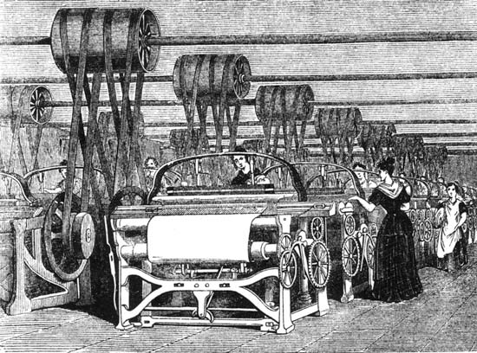
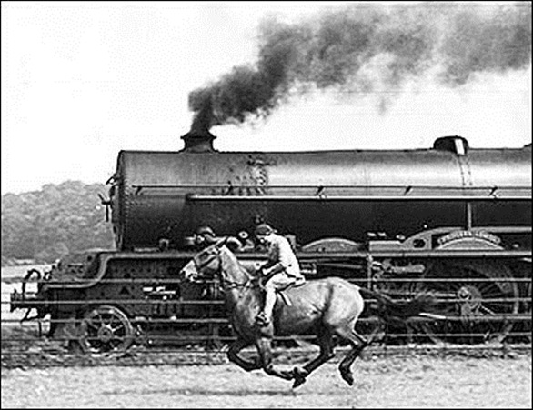
I. Industrial Revolution
• In England, machinery run by water power and later by steam power was used to manufacture cloth -- people started to work in factories instead of working at home.

Slide 7
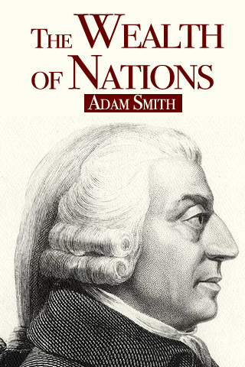
Industrial Revolution in the U.S.
• Took place when the U.S. was born and Adam Smith’s book was published;
• Early decisions by leaders,
eg. Hamiltonian measures (protective
tariff) encouraged business and
industrial growth.

Slide 8
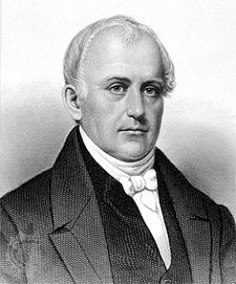
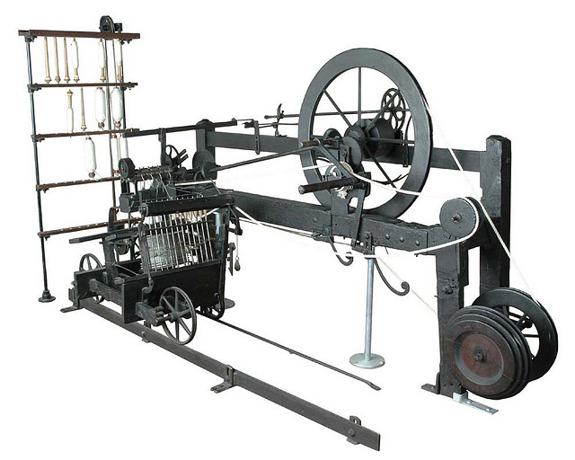
1. The introduction of the factory system
The first factory in the U.S. -- a cotton textile mill built by an Englishman Samuel Slater in Pawtucket, Rhode Island (1793)
The success of Slater’s factory turned the northeastern region of the U.S. into an important manufacturing center, and the nation a major cotton producer.
Samuel Slater

Slide 9
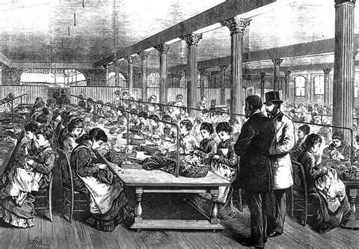
2. The “American system” of mass production
• originated in the firearms industry about 1800.
• required precision engineering to create parts that were interchangeable, which allowed the final product to be assembled in stages, each worker specializing in a specific operation

Slide 10
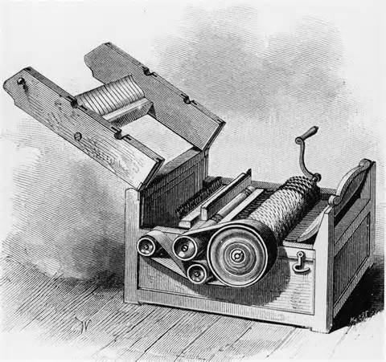
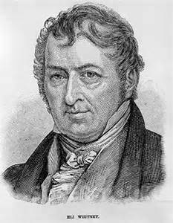
Eli Whitney
made cotton production more efficient by inventing the cotton gin
making guns with machinery, producing interchangeable parts
Eli Whitney

Slide 11
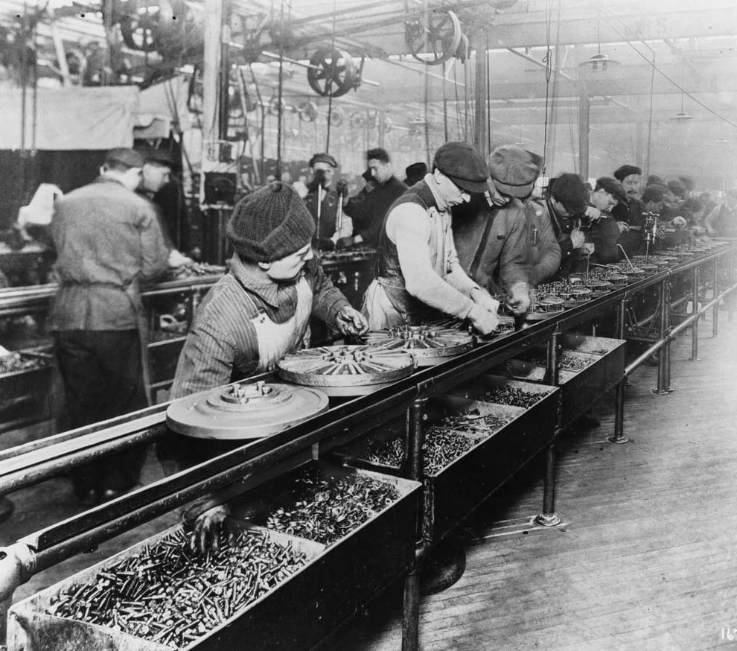
“Moving assembly line” – Henry Ford
• improved efficiency, saved labor costs
“scientific management” lowered the costs of production
higher wages for workers and lower prices for consumers
The moving assembly line

Slide 12
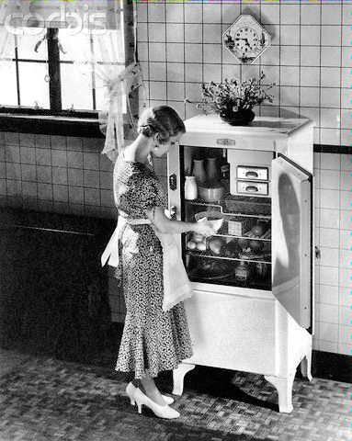
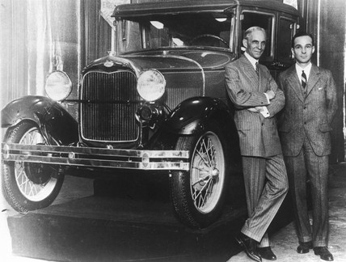
Mass production of consumer goods helped to revolutionize the ways in which Americans lived.
Refrigerator in the 1920s

Slide 13
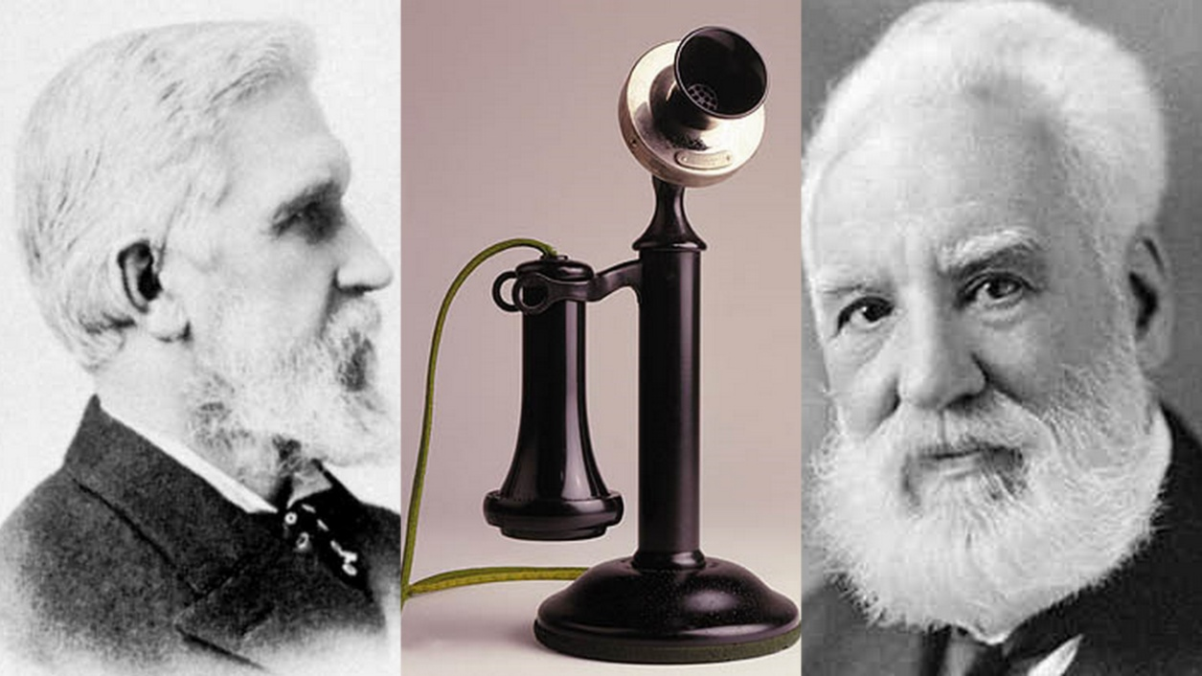
3. Application of new technologies to industries
• The 19th century
-- textile industry switch to steam power
-- new inventions stimulated economic activity (eg. farm
machinery, sewing machines, the telegraph, railroads,
the telephone, the camera etc.)
Bell and the invention of telephone

Slide 14
The 20th century
-- the airplane, the use of aluminum, radio,
television, electric household products
and computers
The first generation of computers

Slide 15
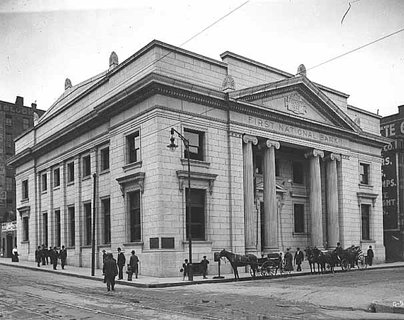
4. New forms of business organization – bank & corporation
the first American commercial bank (the 1780s);
a national banking system with a standard paper currency (1863)

Slide 16
Corporations
corporation to have irresistible advantages over the sole proprietorship and the partnership
Connecticut was the first state to pass a general act of incorporation (in 1837)

Slide 17
5. The construction of railroads
beginning in the 1830s, marked the start of a new era for the United States;
Congress set aside public land for the first transcontinental railroad in 1862
increased business activities and the spread of settlements
created a growing demand for coal, iron and steel, and facilitated the expansion of heavy industries that expanded

Slide 18
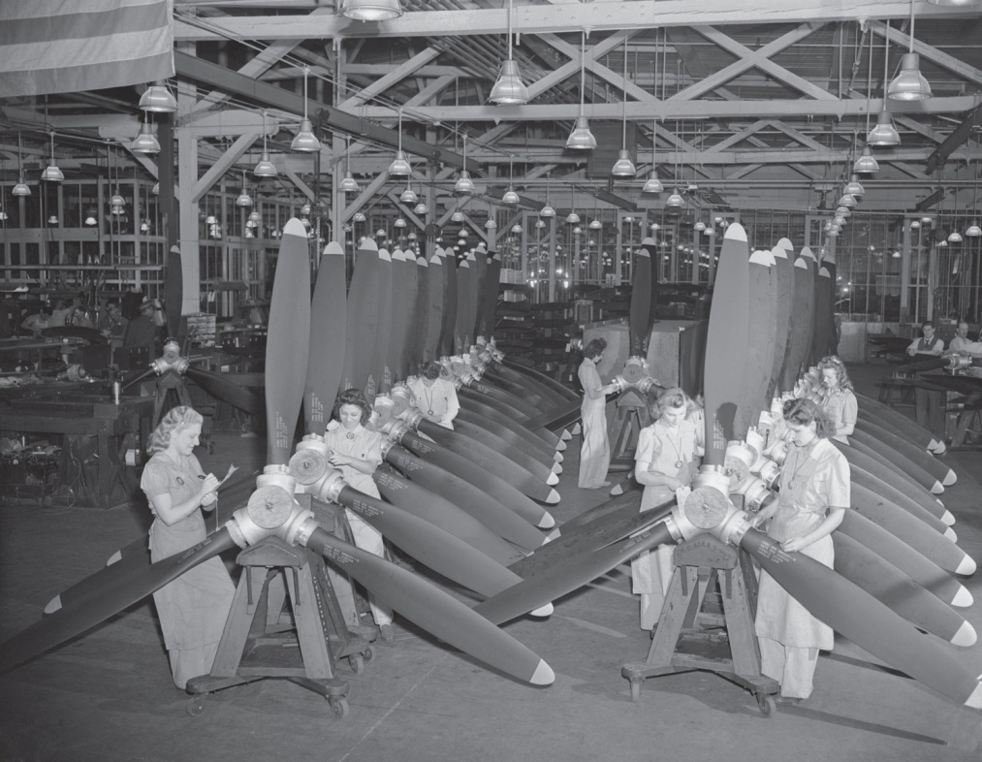
By 1913, more than one-third of the world’s industrial production came from the United States;
Two world wars boosted industrial development -- by 1945, the U.S. had the greatest productive capacity of all of the world’s nations.
Women in aircraft industry WWII

Slide 19
The 20th century
high-tech industries have grown and older industries have declined
Service industries dominate the economy
-- the U.S. has moved into a “post-industrial era”

Slide 20
II. Free Enterprise
• capital – money needed to start and develop new businesses
• stock/share – a small proportion of a business
• stock exchanges – places where shares/stocks are bought and sold
Alibaba Group go public at New York Stock Exchange

Slide 21
Problems with industrial capitalism
low wages, long working hours, unsafe and unhealthy working conditions; child labor
discrimination in hiring
Monopolies that eliminates competition, sets high prices for goods and produces poor quality merchandise

Slide 22
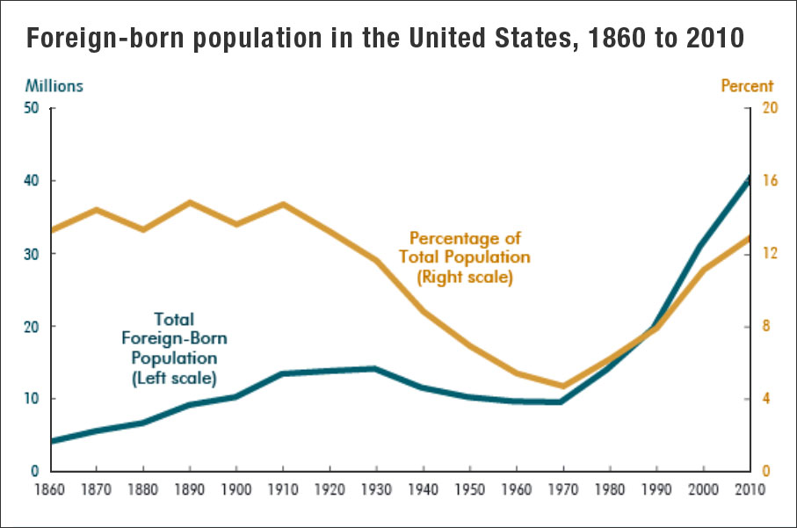
III. The Roots of Affluence
1. Vast geographical size, rich natural resources, population trends
4th largest country; more than 310 million people; waves of immigration provide both workers and consumers for American businesses

Slide 23
2. Religious, social and political traditions
mobility – geographical, social and economic
entrepreneurial spirit – derived from a “Puritan ethic” or “Protestant ethic”; or a material acquisitiveness

Slide 24
3. institutional structures of government and business
limit governmental powers to intervene in economic activities
widen opportunities for individual initiative

Slide 25
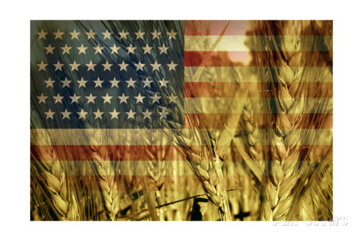
IV. American Agriculture
• Agriculture and its related industries serve as the foundation of American economic life.
• Agricultural -- a spirit of individualism and egalitarianism -- have been adopted and celebrated by the society as a whole.

Slide 26
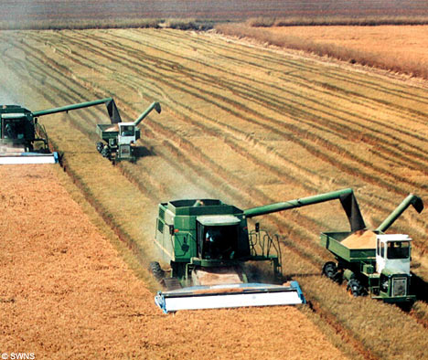
American agriculture’s richness and variety due to --
the vastness of the nation
the generosity of nature
The U. S. produces half of the world’s soybeans and corn for grain, and from 10-25% of its cotton, wheat, tobacco and vegetable oils.

Slide 27
“agribusiness”
covers the entire complex of farm-related businesses -- farmer cooperatives, rural banks, shippers of farm products, commodity dealers, firms that manufacture farm equipment, food-processing industries, grocery chains and many other businesses.

Slide 28
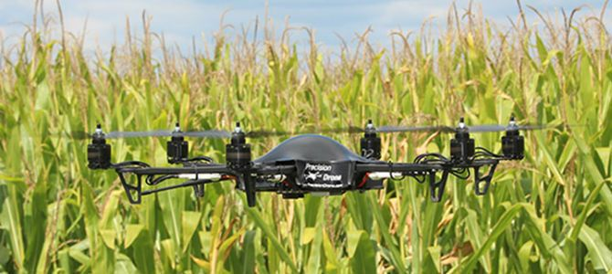
one-third of the cropland in the U.S. is planted in crops for export -- to Europe, Asia, Africa and Latin America;
the standard of living of American farmers is generally high;
new technology, such as computer, has been adopted to cut costs and improve productivity

Slide 29
American agriculture has dark sides
1. Farmers go through alternating periods of prosperity and recession
-- In the early 1980s, agricultural exports declined, crop prices fell and interest rates rose
-- The number of small farms dropped by 120, 000 between 1982 and 1987

Slide 30
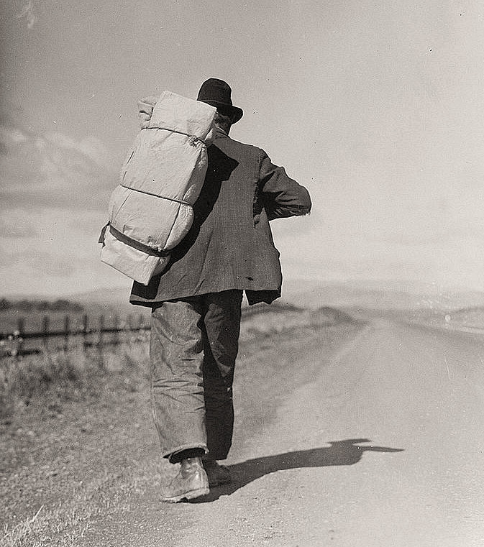
migrant workers
seasonal workers travel from farm to farm, hired only for a specific chore, such as picking crops;
some are housed under poor conditions, have inadequate health care, and are paid low wages.

Slide 31
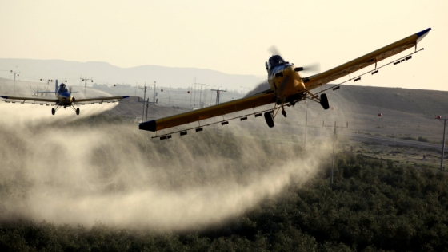
2. Farm practices raised environmental concerns
artificial fertilizers and chemicals damaging water quality
Toxic chemicals caused cancer and other diseases

Slide 32
V. The Recession
• The financial crisis started in late 2007, triggered by a liquidity shortfall in the United States banking system;
• Some believe the problems are deep-seated, revealing defects in the free market system and US government financial policies

Slide 33
Questions for Discussion
It is known to all that buying and selling stocks is a risky business. Why do you think there are still so many people involved in it?
Give examples of industries which are declining, and industries which are fast developing in the United States.
What is the current economic situation in the U.S.? How did the financial crisis of 2008 start? What does it show?

Slide 34
The End
高等教育出版社
2015

